Slide 1
World Armed Forces
By Sneha ( NU ID: 001264089 )
Pujitha(NU ID: 001222891)
Manav Desai (NU ID: 001253310)

Slide 2
Problem Statement
There are many people who join the segments of the armed forces such as navy, army and air force. These armed forces co-exist in environment where there several bodies responsible for giving permissions, seeking permissions, granting the allowances and communicating with other bodies which needs to be organized for smooth functioning so as to ignore miscommunications and time complexities.

Slide 3
Proposed Solution
The objective of this project is to create an application to cater to the needs and provide facilities to the people working in navy, army, air force. Government is the regulatory body which provides permission to the armed forces in times of emergency and is responsible for budgeting and to provide weapons when there is a shortage of weapons in the respective armed forces.
Not only this, our application also aims at handling the data.

Slide 4
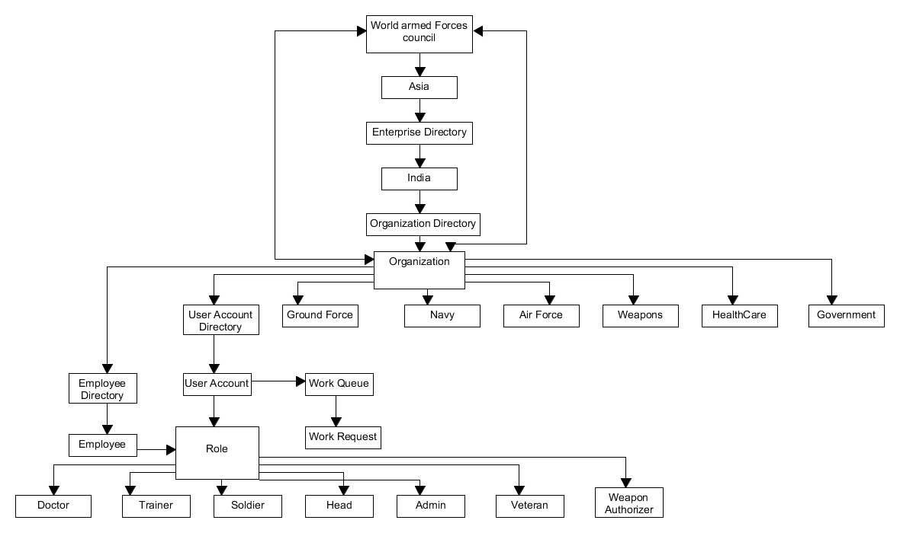
Object Model

Slide 5
Key Roles
Doctor : Accepts the appointment requests and acts upon it.
Soldier : Soldier requests for weapons to the head and requests for appointment from the doctor in case of injury..
Head of Armed Force : Head has the authority to accept or reject weapon requests from the soldier as well as he can request permission for war from the government .
Weapon Authorizer : After getting the request from soldier, head requests weapon authorizer for weapons. Weapon authorizer has an authority to accept/reject the this request.
Government : Government is capable of accepting or rejecting war requests and weapon requests.
Trainer: Has functions similar to that of soldier but cannot request for weapons. He might as well book an appointment for injury.
Veteran: He will be able to view his details after signing up and can schedule an appointment with doctor.

Slide 6
Key Features
Soldier/head can request for the weapon they need.
Based on the request, respective head of the segment/Weapon Authorizer will grant the required weapons to genuine soldier/head who needs it.
Soldier, trainer, veteran can schedule an appointment with the doctor in case of injury.
Doctor will be able to pull the request. He can either accept the request or decline it.

Slide 7
Extra Features
From the past history, soldier can predict the number of weapons which he might require and based on that he can make an assumption of the weapons he needs.
Government and Weapons Authorizer will be able to accept all the requests or accept a particular request and decline the request.

Slide 8
Thank You

